Slide 1
BEATBOT
gROUP 2: Bowie Hand, Darya Rudych, Jessica Serna, Lu Wang, Shweta Banerjee, Ydidya Erque

Slide 2

Project GOAL
Input Data
AI Magic
New Music Hit

Slide 3


CAN YOU GUESS?
Audio A
Audio B
Audio C
Audio D
Notes:
Answers: A – Machine; B – Dream A Little; C – A Kalina, D – Machine. In case they all sound bad to you, that is because all songs have been quantized to the same volume and semitone

Slide 4
Model choice: CBLTSM RNN
WHY?
RNN is best suited for sequential information as they perform the same function for every single element of a sequence, with the result being dependent on previous computations.
LTSM uses a gating mechanism that is able to recognize and encode long-term patterns. LSTMs are extremely useful to solve problems where the network has to remember information for a long period of time as is the case with music.
CBLTSM is specific to replicating patterns in text. Being a recurrent neural network it stores memory as it moves along learning patterns and understanding the concept of cause and effect. Music can be represented as text (notes ABC etc) which is convenient since text is lightweight and discrete which makes training fast. In addition, once CBLTSM is set up it can generate output indefinitely. There is no maximum length of generated music.

Slide 5
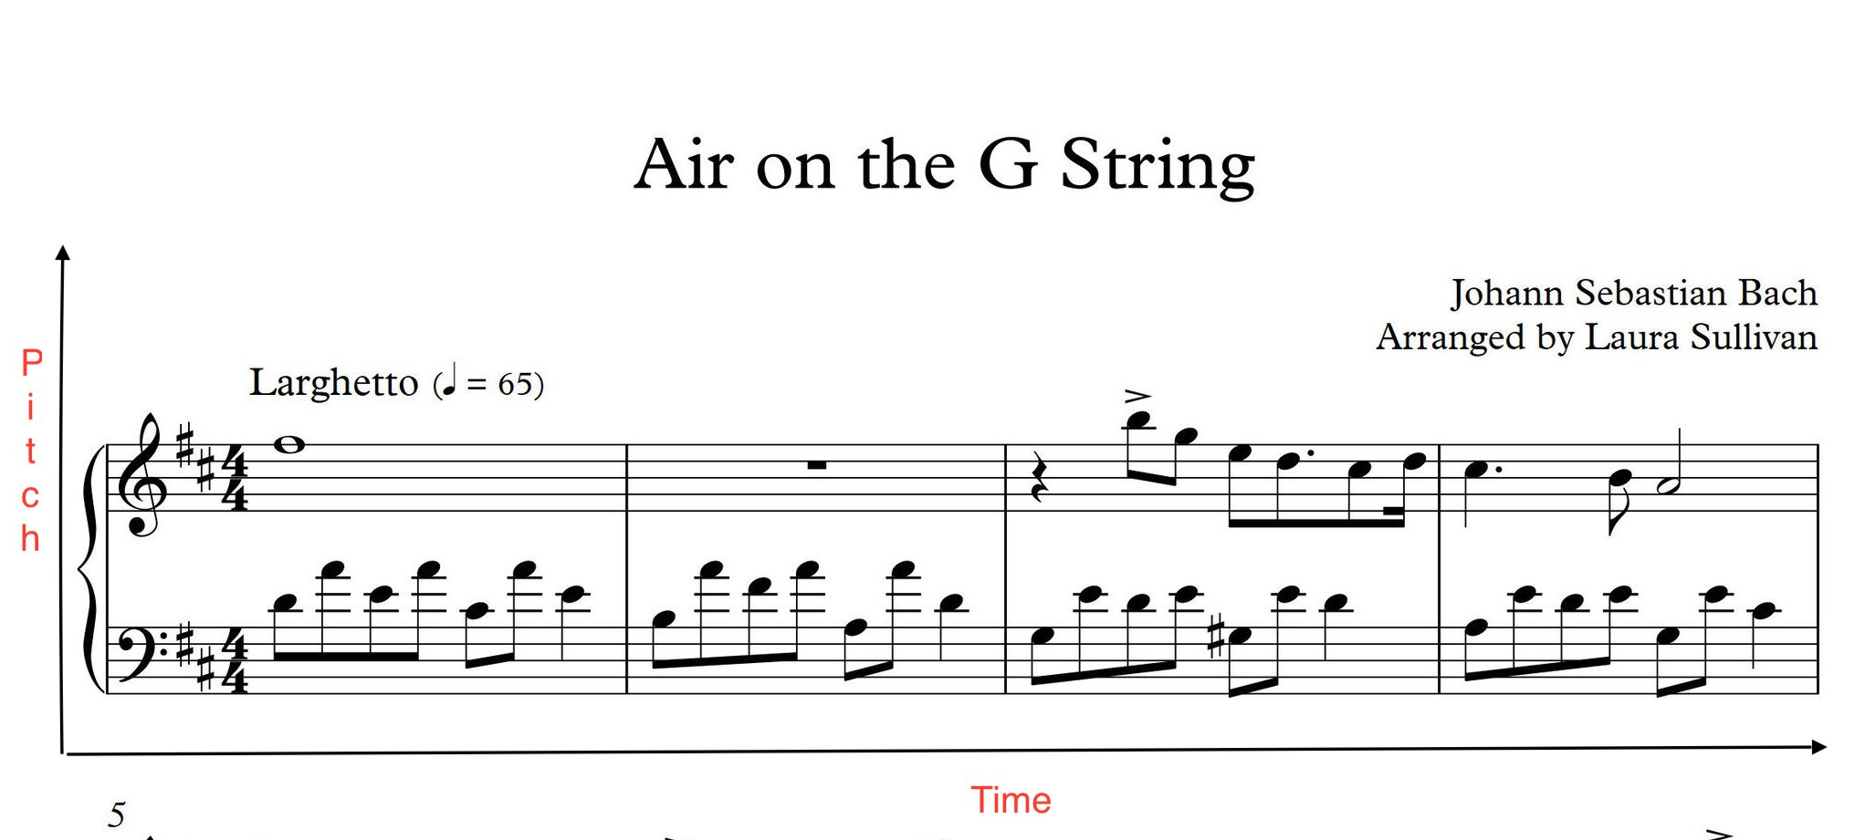
Model choice: CBLTSM RNN
Downsides:
Music is inherently 2-dimensional. Two notes of different pitches can both play at the same time and two notes of the same pitch can play at different time and text is not the best way to represent that.
Text, being 1-dimensional, is good but not the best way to represent music

Slide 6
DATA Preparation
1. MIDI (Musical Instrument Digital Interface)
Contains information about: note, pitch, octave, chord, offset
2. Music21 toolkit
MIT Python library to extract data from MIDI
* Reference for music terminology
Note: A note is either a single sound or its representation in notation. Each note consist of pitch, octave, and an offset.
Pitch: Pitch refers to the frequency of the sound, represented with the letters [A, B, C, D, E, F, G], with A being the highest and G being the lowest.
Octave: An octave is the interval between one musical pitch and another with half or double its frequency.
Offset: Refers to the location of the note.
Chord: Playing multiple notes at the same time constitutes a chord.

Slide 7
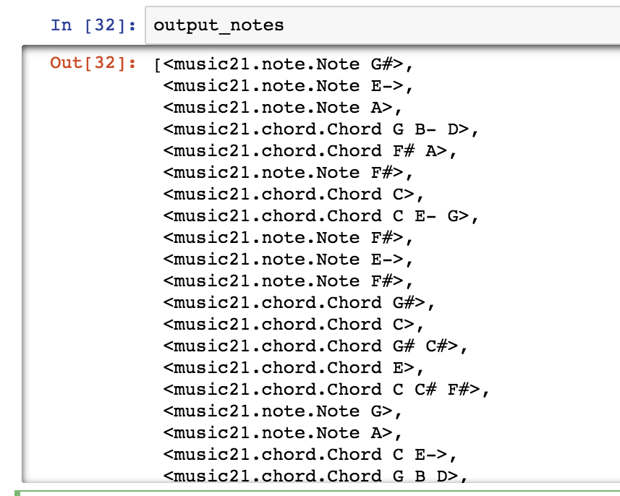

DATA Preparation
An excerpt from a midi file that has been read using Music21

Slide 8
Data Preparation
Genre | # Midi | # Notes/Chords | #Unique notes/chords
Jazz | 149 | 134123 | 702
Blues | 99 | 79510 | 390
Country | 90 | 49310 | 238
Rap | 99 | 85450 | 402
Ukrainian folk | 66 | 28194 | 382
Bollywood | 68 | 59039 | 570
Notes:
We start by loading each file into a Music21 stream object using the converter.parse(file) function. Using that stream object we get a list of all the notes and chords in the file.

Slide 9
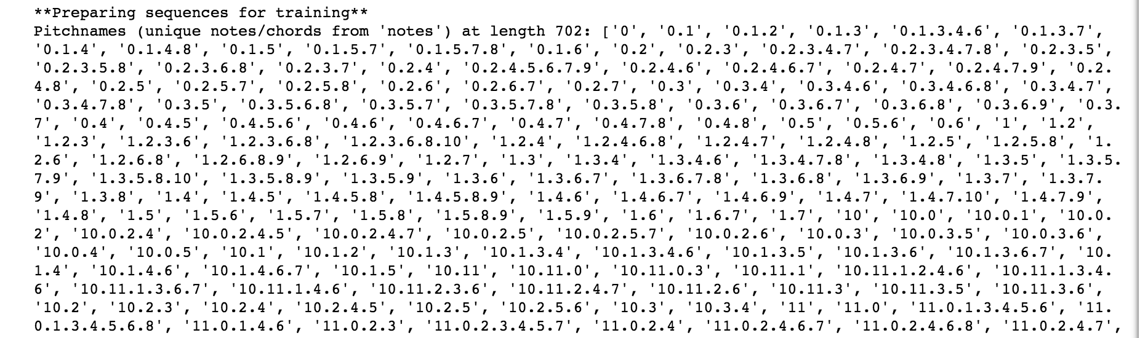
Data Preparation : network input
Assign an id to each unique note
Append every chord by encoding the id of every note in the chord together into a single string, with each note being separated by a dot.
These encodings allows us to easily decode the output generated by the network into the correct notes and chords.
Note to integer embedding

Slide 10
Data Preparation: network input
Prepare input sequences (seq_len = 100/200) and the corresponding outputs
Normalize the input

Slide 11
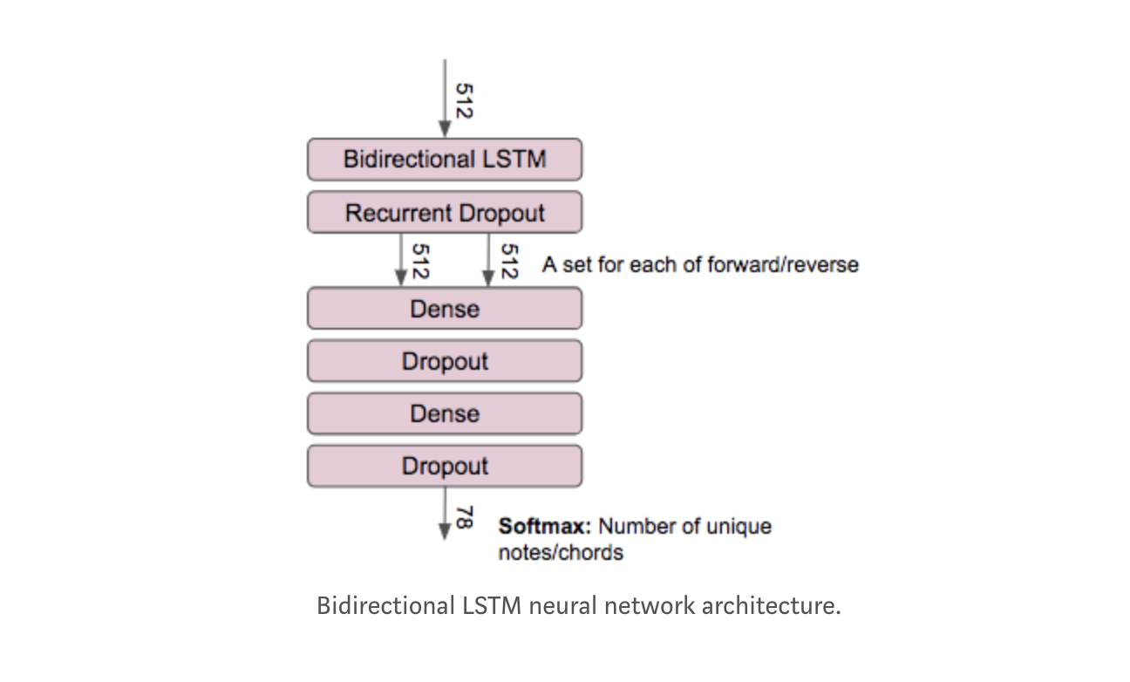
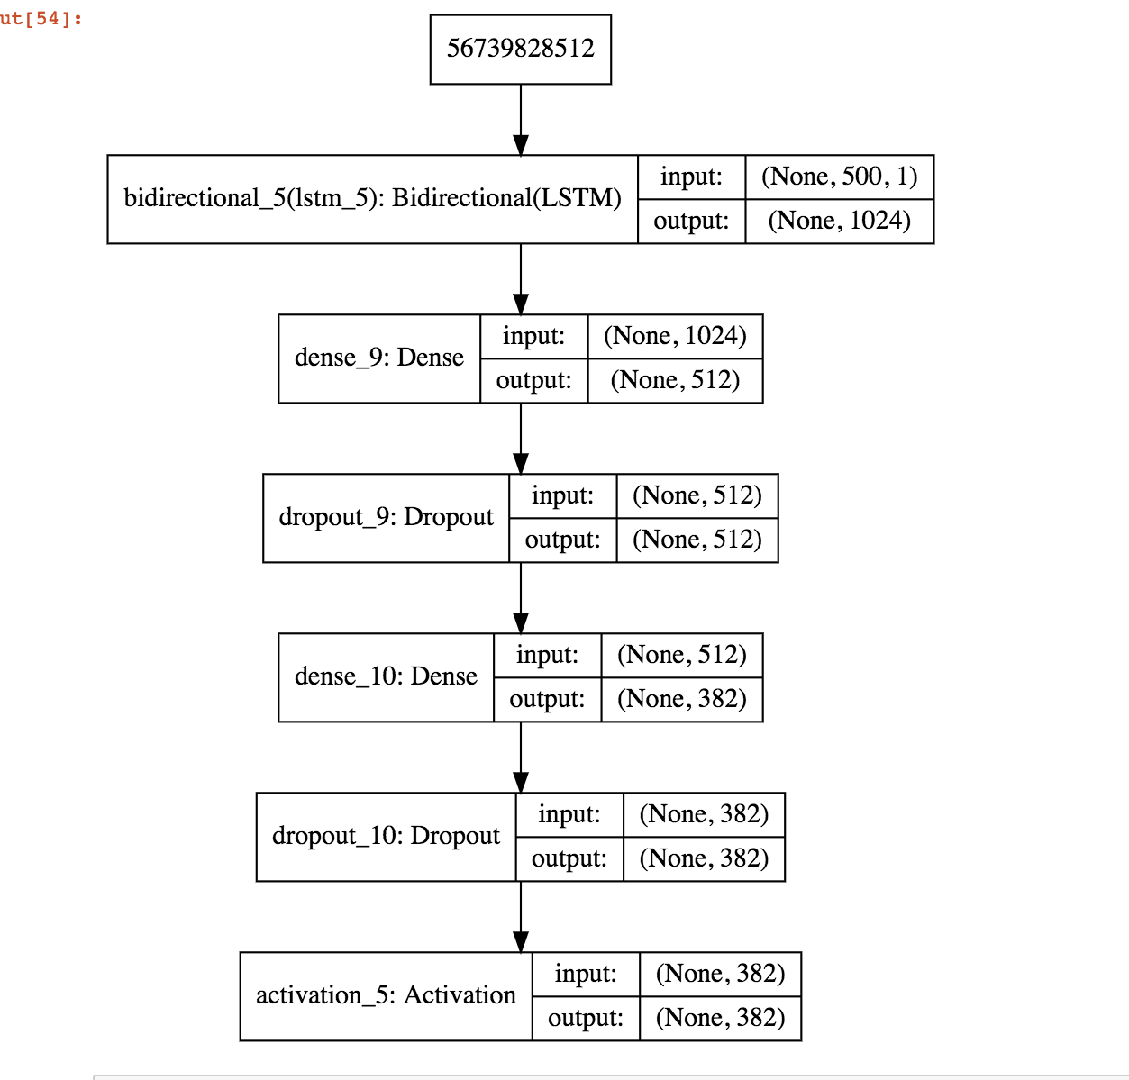
Model Architecture

Slide 12
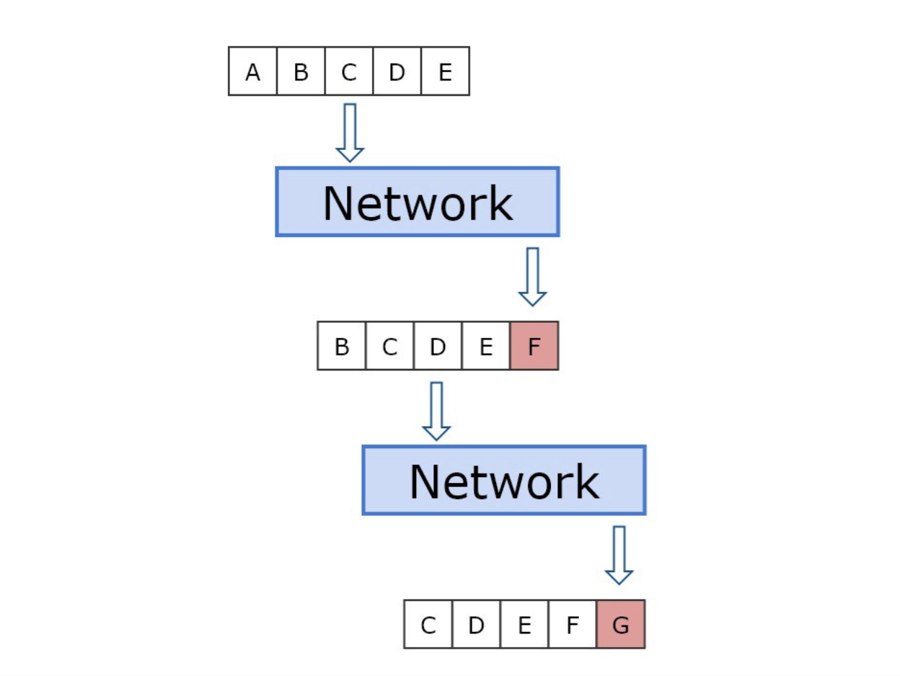
GENERATING MUSIC
For each note that we want to generate we submit a sequence to the network.
First sequence at a random starting point
Sequence shifts over one by one until the model has generated a full sequence of the requested notes

Slide 13
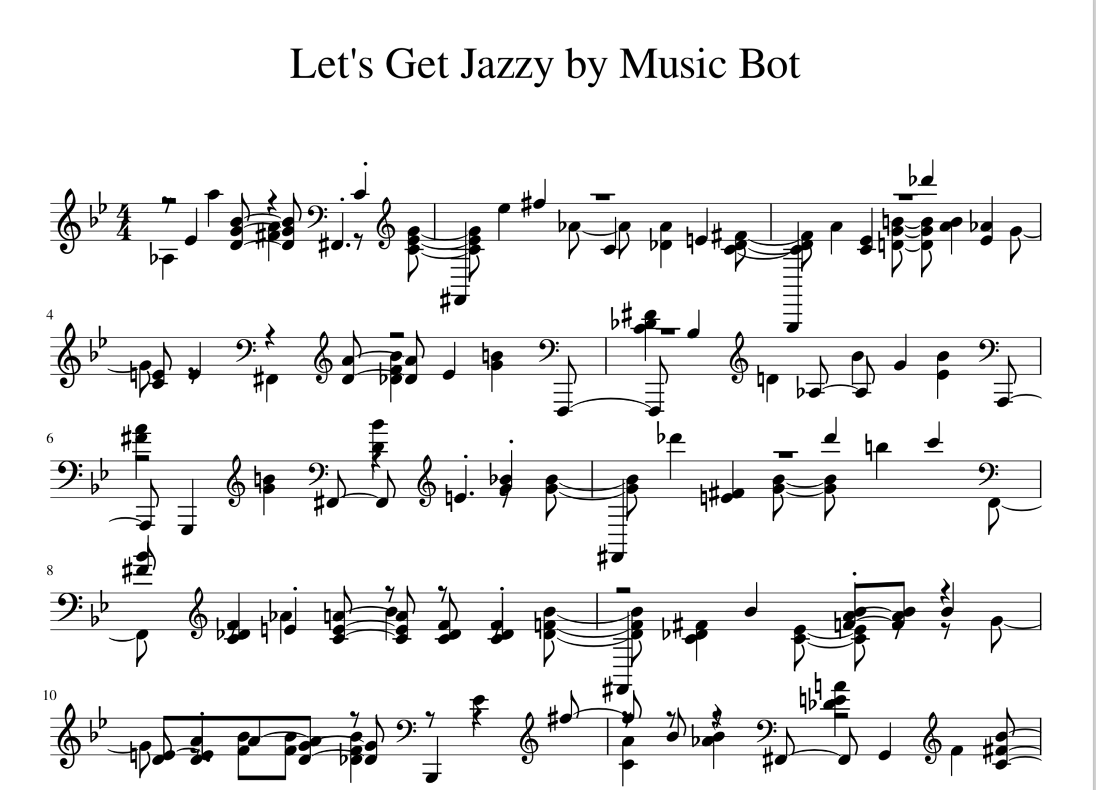
Let’s HEAR it!

Slide 14
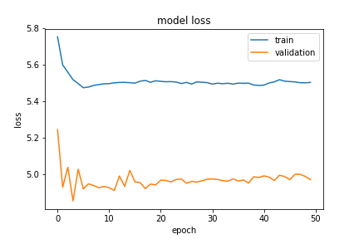
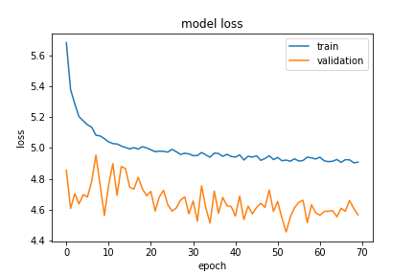
Model evaluation
Jazz Data, 50 epochs, seq_len = 100
Bollywood Data, 70 epochs, seq_len = 200

Slide 15
Challenges
Lack of music background
Lack of DATA
Polyphonic tunes are hard to encode
Genre selection
VERY LONG training runtime

Slide 16
Future scope
Run data models and sampling on distributed cluster to reduce processing time
Make the music generator real-time
Provide additional features to users, so that they can upload their own music library and generate new music

Slide 17
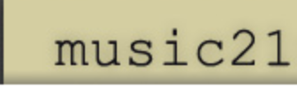
Technologies USED

